Slide 1
PHYS 150: Programming for Physics
An introduction

Slide 2

About me
Shenglong Xu
Assistant Professor, Department of Physics & Astronomy
Office: MPHY 404
Email: slxu@tamu.edu
B.S in Physics, Nanjing University 2007-2011
Ohio State University 2011-2013
Ph.D in physics, University of California, San Diego 2013 - 2017
Post-Doc, University of Maryland, 2017-2020
Texas A&M, 2020 -

Slide 3
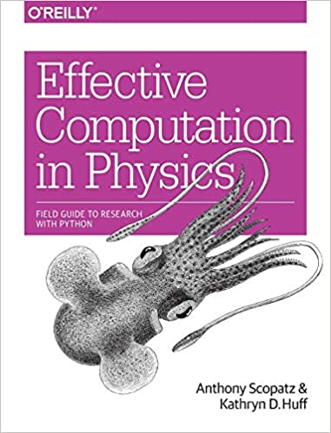
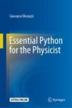
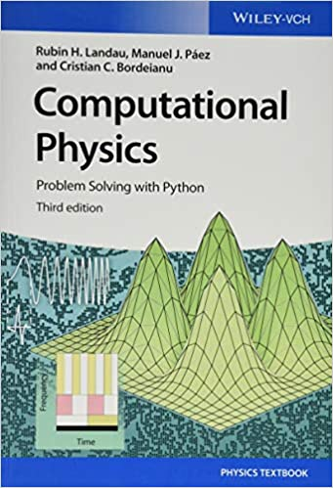
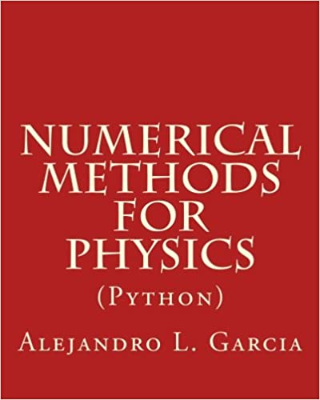
Course Information
Learning Management System: Canvas
Books on computational physics using python
More advanced
available as e-book at TAMU library
https://link.springer.com/book/10.1007/978-3-030-45027-4
available as e-book at TAMU library

Slide 4
What is Programming used for?
apps
videos games
Weather forecast
webpages
…

Slide 5
What is Programming?
“Computer programming is the process of designing and building an executable computer program to accomplish a specific computing results…The purpose of programming is to find a sequence of instructions that will automate the performance of a task” – From Wikipedia

Slide 6
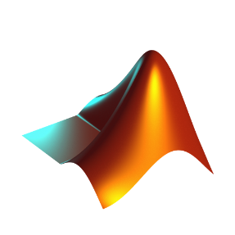






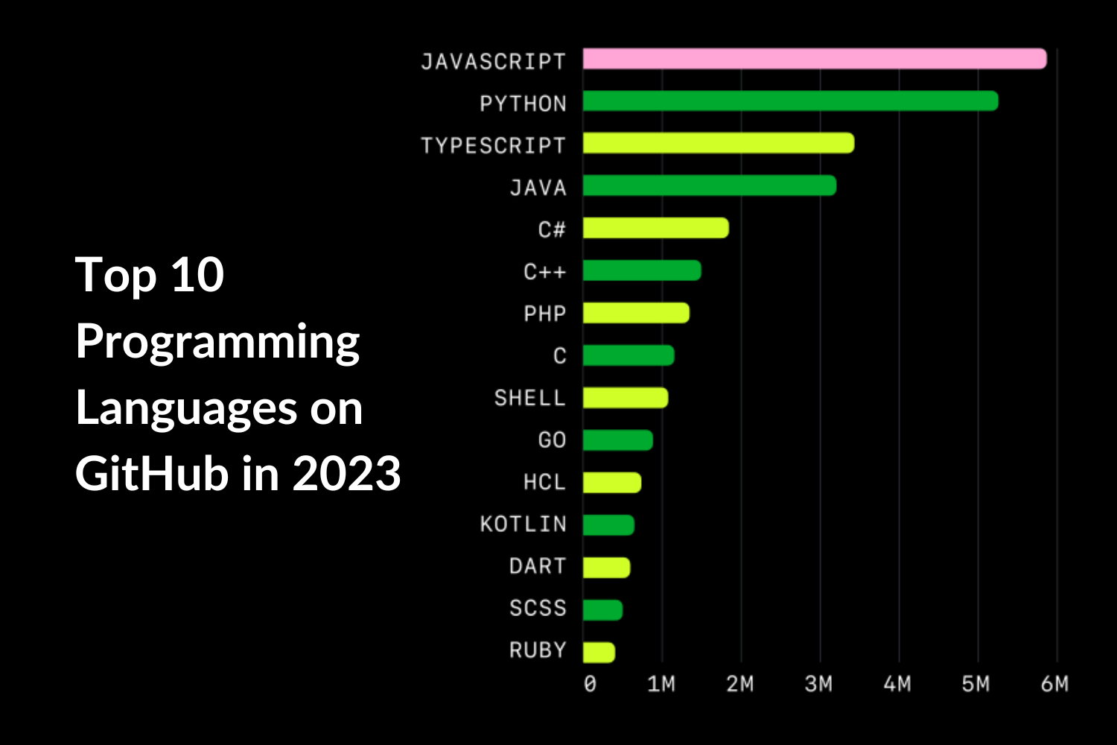
Commonly used software and programming languages
MATLAB
Mathematica
python
Science and Engineering

Slide 7
What is Programming used for in physics?

Slide 8
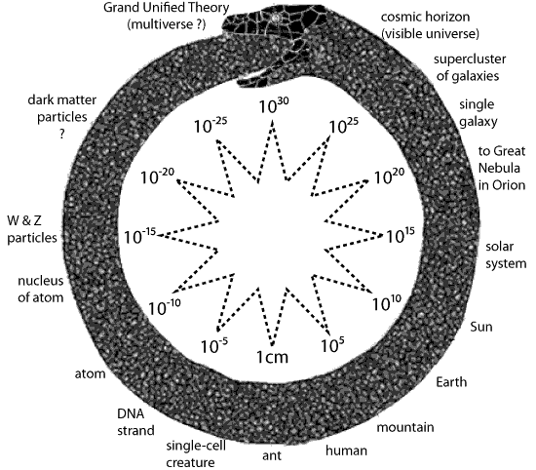
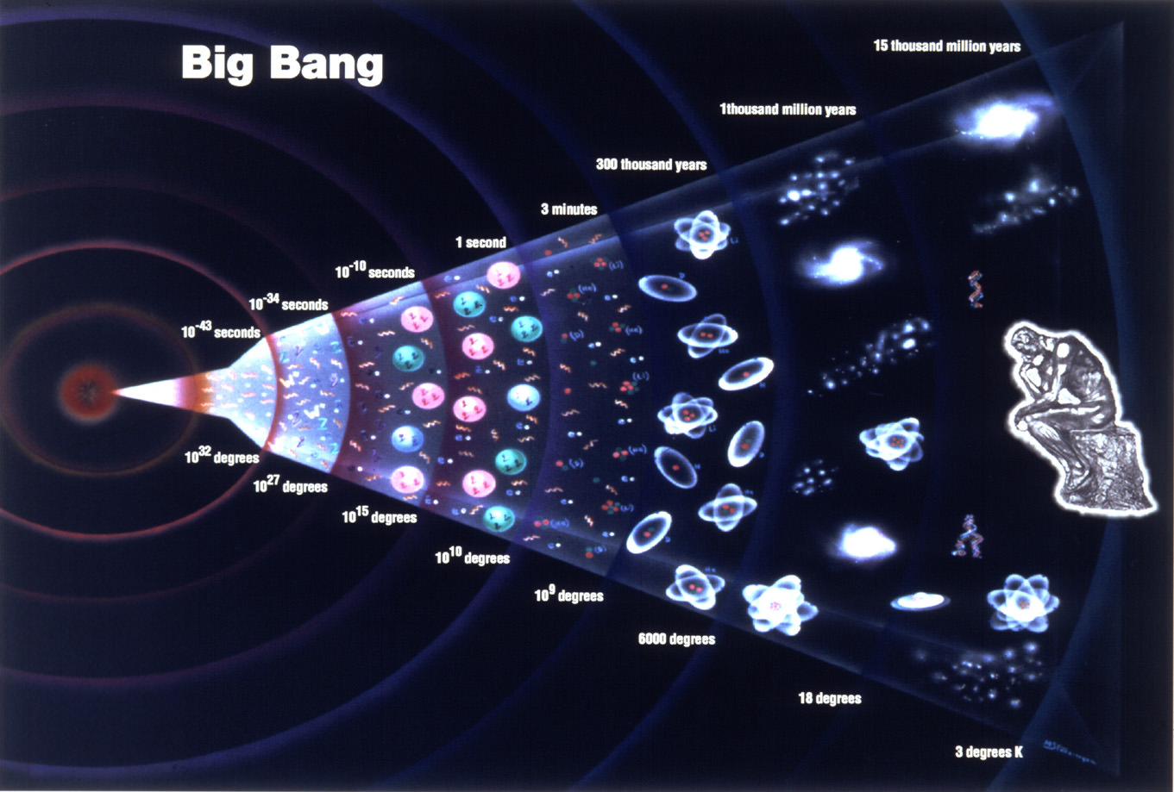
Physics studies natural phenomena at all scales, from galaxies to atoms, from the big bang to the future.
Adapted from Nancy Ellen Abrams and Joel R. Primack (The View From the Center of the Universe: discovering our extraordinary place in the cosmos, 2007)

Slide 9
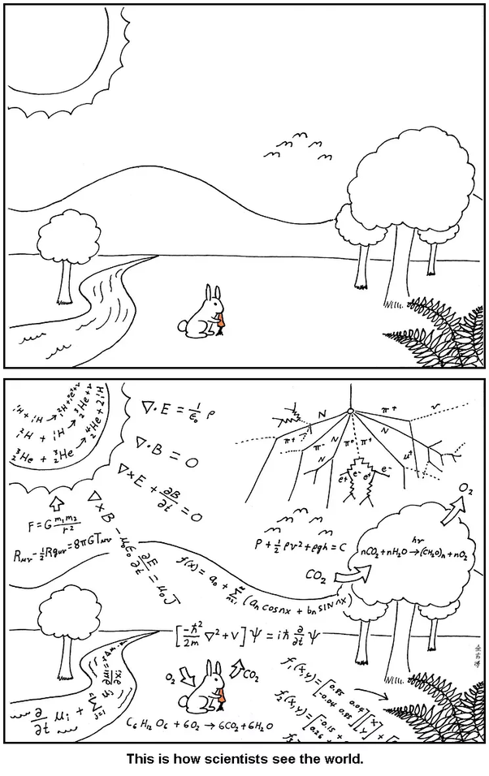

“Everything should be made as simple as possible, but not simpler.” -- Einstein

Slide 10
From complex phenomena to fundamental nature laws
From fundamental nature laws to understand/predict new phenomena and design new applications

Slide 11
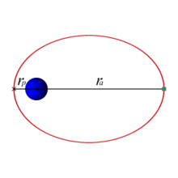
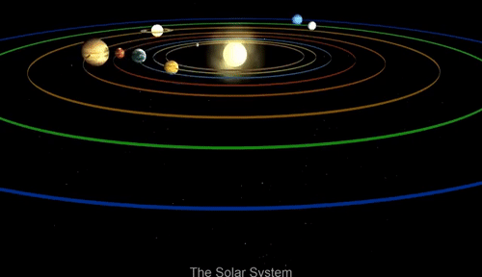
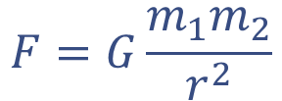

Newton’s law of universal gravitation (1687)
$$F=G\frac{m_{1}m_{2}}{r^{2}}$$
Newton’s second law
$$F=ma$$

Slide 12
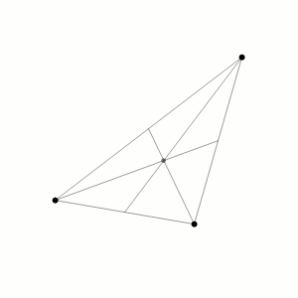
Newton’s law of universal gravitation (1687)
$$F=G\frac{m_{1}m_{2}}{r^{2}}$$
The three body problem

Slide 13
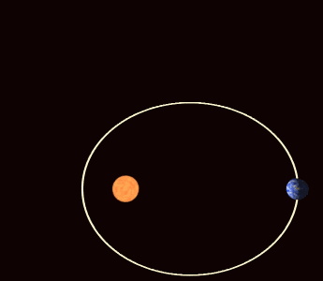

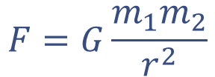
Newton’s law of universal gravitation (1687)
$$F=G\frac{m_{1}m_{2}}{r^{2}}$$
Einstein's General Relativity (1915)
$$G_{μν}+Λg_{μν}=κT_{μν}$$

Slide 14
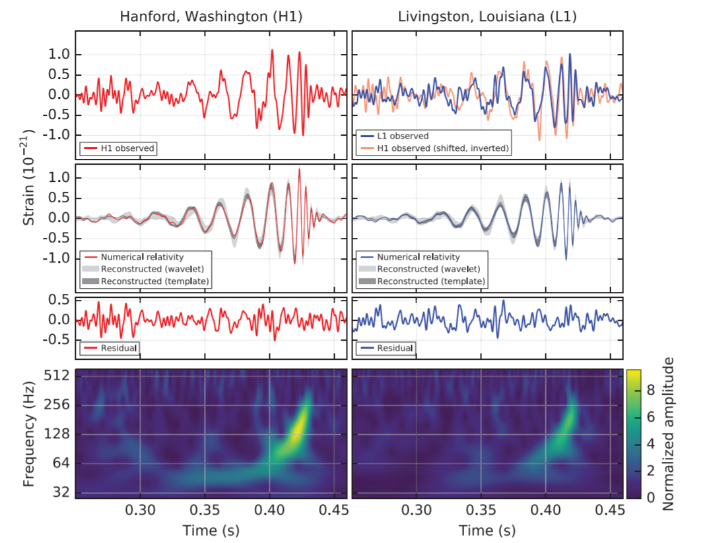
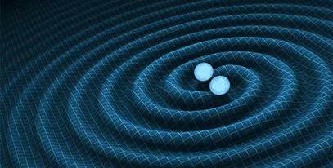
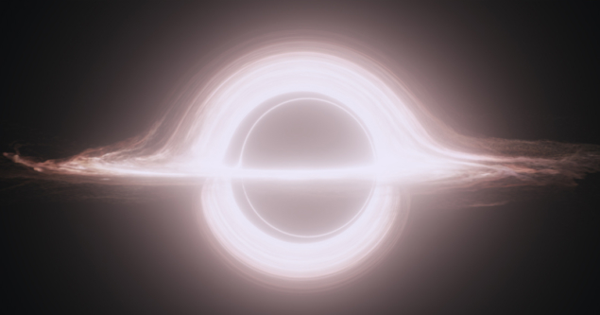
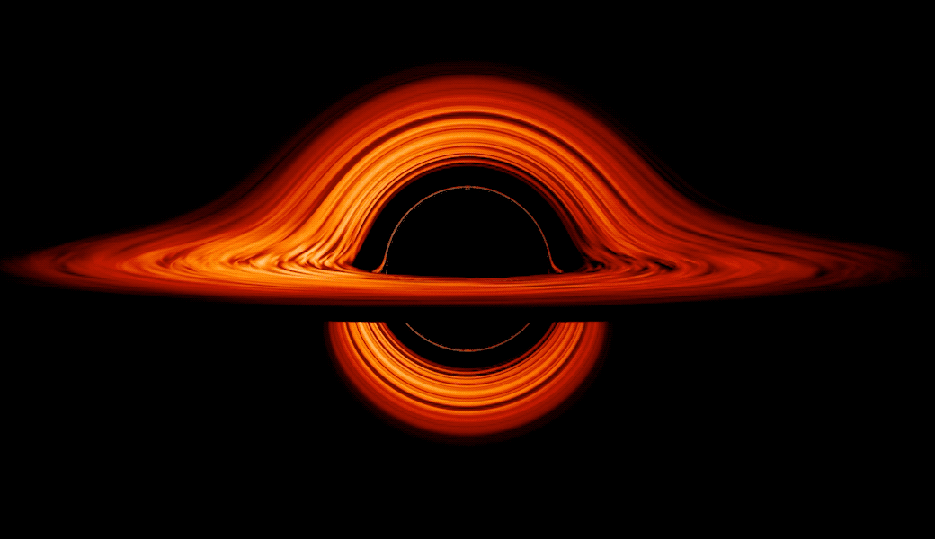
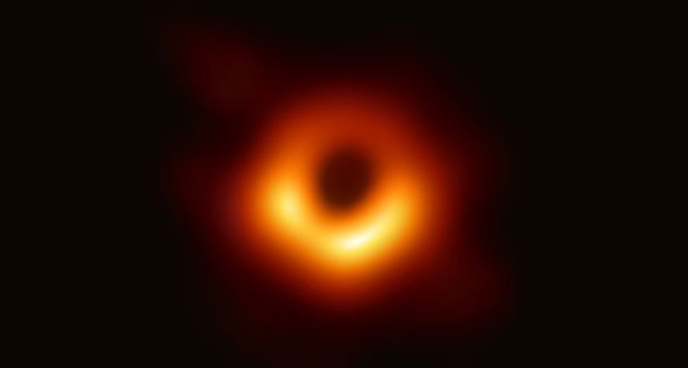
“ripples in spacetime”
The first observation of gravitational wave predicted by general relativity (LIGO, 2015)
Gargantua A variant of the black-hole accretion disk seen in the film Interstellar. Credit: DNEG/Warner Bros. Entertainment Inc./CQG 32 065001 (a 2014 film)
Credits: NASA’s Goddard Space Flight Center/Jeremy Schnittman
The first picture of black hole from The Event Horizon Telescope (2019)

Slide 15

“Everything should be made as simple as possible, but not simpler.” -- Einstein

Slide 17
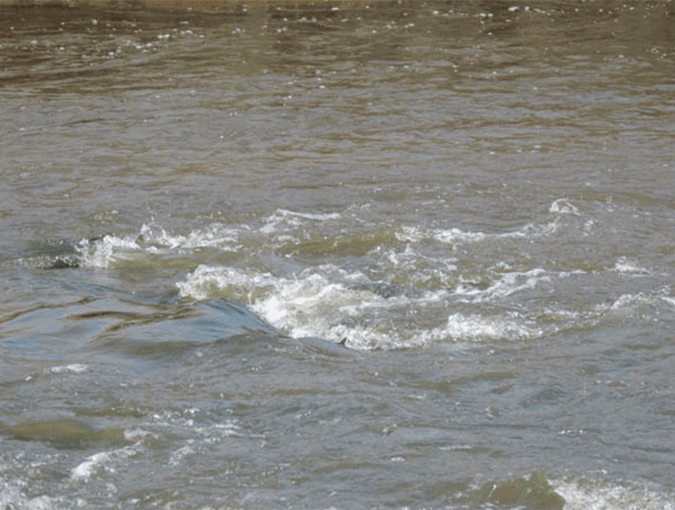
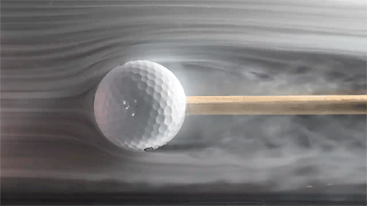
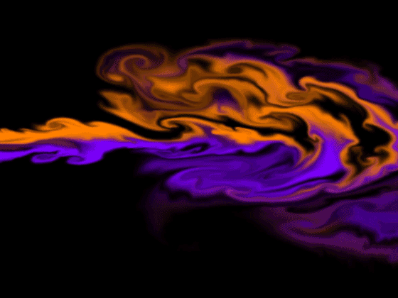
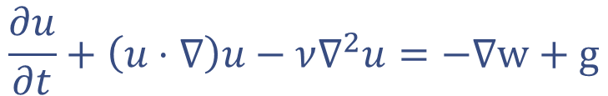
Laminar vs Turbulence flow of water
Navier-Stokes Equations for water
$$\frac{∂u}{∂t}+\left(u⋅∇\right)u−ν∇^{2}u=−∇w+g$$

Slide 18
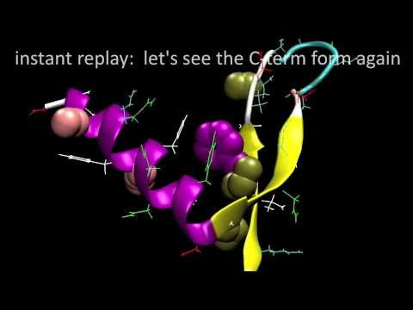
Biophysics: protein folding, cell membrane dynamics, organisms…
Molecular dynamics simulation of ~1000 atoms
Newtonian dynamics
Impossible to solve it use pencil and paper
https://pubs.acs.org/doi/full/10.1021/ja9090353
A lot of programming and softwares

Slide 19

Fundamental laws
Complex Phenomena
Emergence

Slide 20
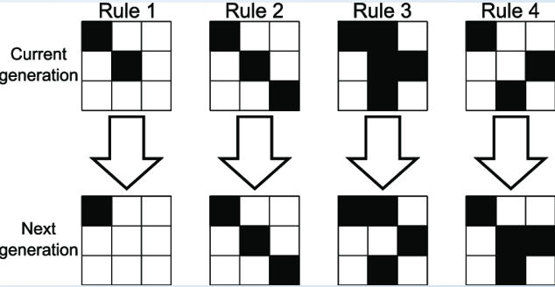
Conway's Game of Life
Any live cell with fewer than two live neighbors dies, as if by underpopulation.
Any live cell with two or three live neighbors lives on to the next generation.
Any live cell with more than three live neighbors dies, as if by overpopulation.
Any dead cell with exactly three live neighbors becomes a live cell, as if by reproduction.
Focus on the middle cell

Slide 21
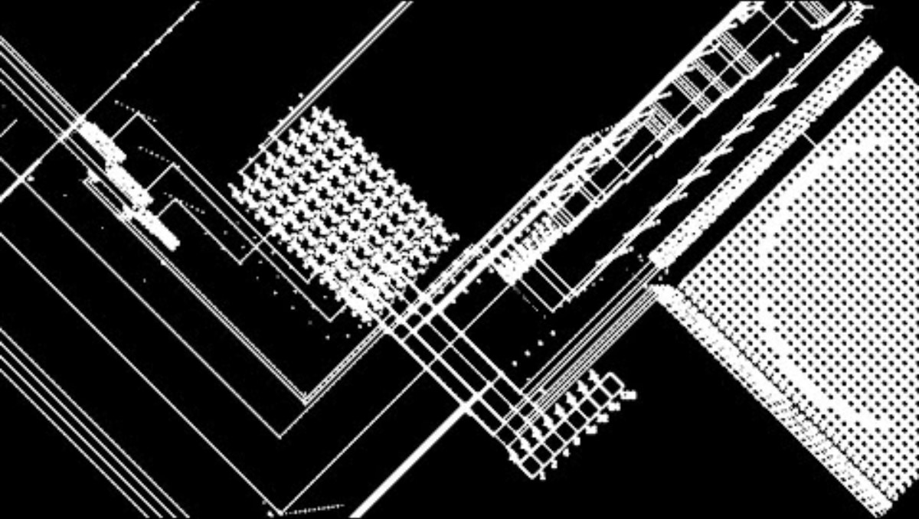



Slide 22
Quantum physics: on the scale of atoms, electrons…
Newton’s second law
Schrodinger’s equation $i\frac{∂}{∂t}\left|ψ\right\rangle =H\left|ψ\right\rangle$
much more difficult to simulate

Slide 23
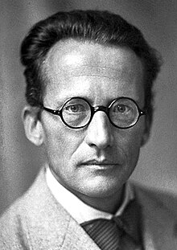
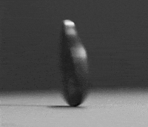
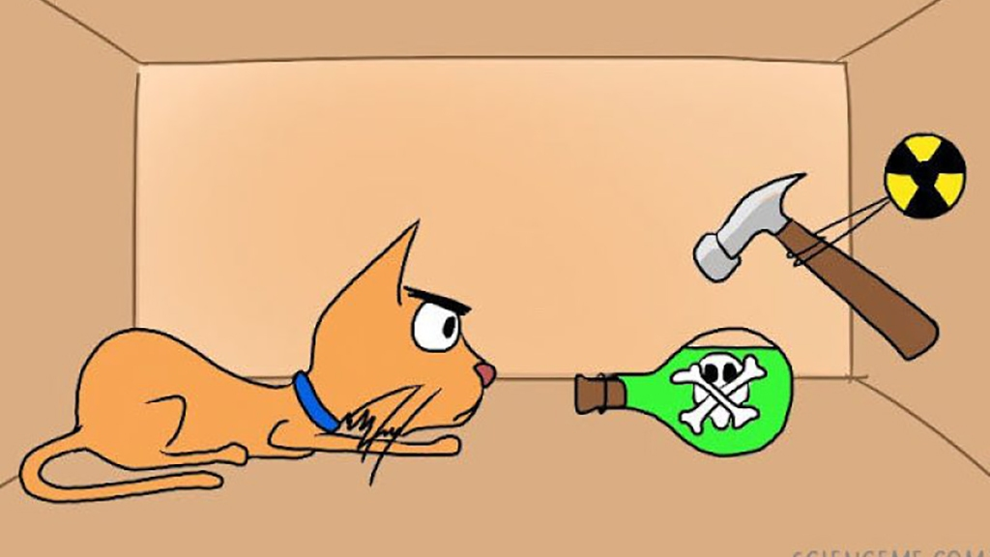
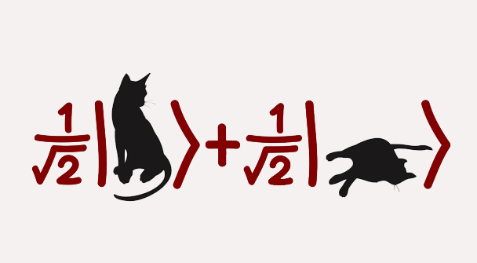
Schrodinger’s Cat (quantum mechanics)
Erwin Schrödinger
superposition of life and death

Slide 24

Now with many cats (microscopic particles) …
How many Schrodinger’s cats can we simulate on a classical computer?
Before open the box, there are $2^{N}$ possibilities with different weights. To simulate those quantum cats, we need keep track all of them and their weight simultaneously.
$2^{10}=1024, 2^{300}>$ # atoms in the universe

Slide 25
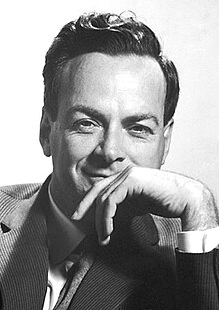
“Nature isn't classical, and if you want to make a simulation of Nature, you'd better make it quantum mechanical, and it's a wonderful problem because it doesn't look so easy.” (1982)
using quantum mechanics to simulate quantum nature
2024: Google, IBM, Microsoft, Amazon ~100 companies
Simulate the Quantum Nature
Material discover, drug design …
Shor‘s algorithm for integer factorization (1994) cryptography
Faster machine learning
Reducing traffic by optimizing driving routes during rush hour in Seattle
…
Richard Feynman
(1918 – 1988)

Slide 26
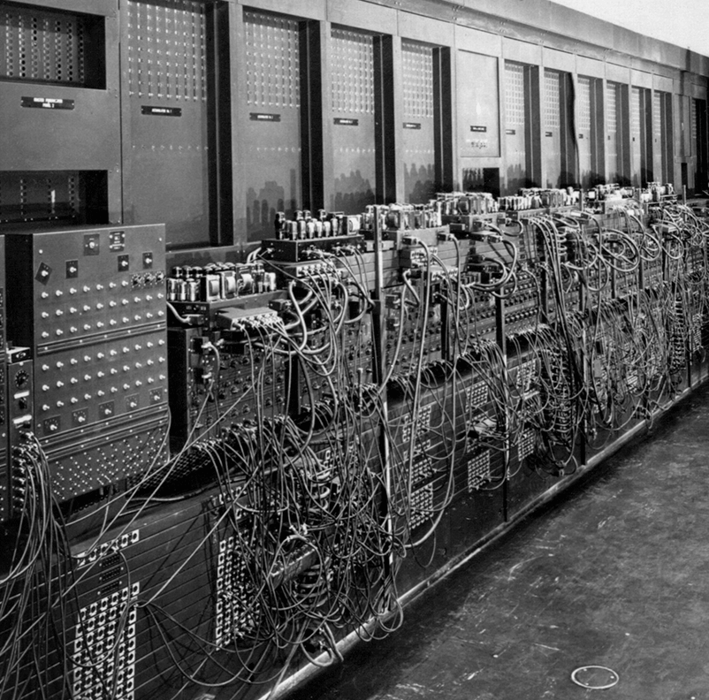
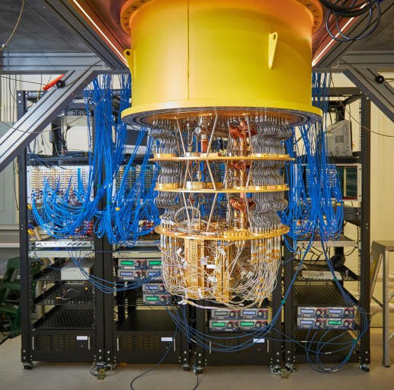
Classical Computer
Quantum Computer
ENIAC:~500 bits
Google Sycamore:~100 qubits

Slide 27
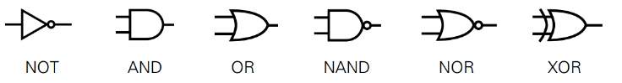
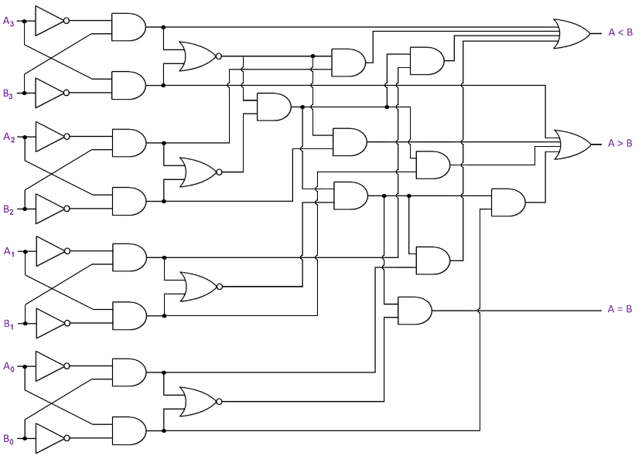
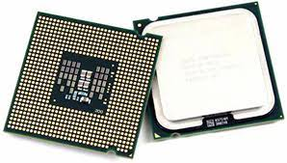

N bits
1
0
0
0
1
0
0
1
B1
B2
B3
B4
B5
B6
B7
B8
1
1
0
1
0
0
0
1
$f\left(B\right)$:
map a bit string to another bit string
input
readout
realized by logical gate

Slide 28
Ultimate dream: the theory of everything
;Universe in a computer
Adapted from Nancy Ellen Abrams and Joel R. Primack (The View From the Center of the Universe: discovering our extraordinary place in the cosmos, 2007)

Slide 29
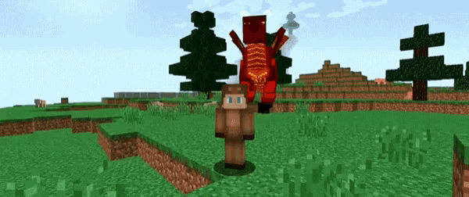
Newtonian Gravity

Slide 30
physics
math
programming

Slide 31

Programming is an important tool in modern physics research
Solving equations
Simulations
Predicting experiments
Controlling equipment
Data analysis
Presentation (making plots and writing papers)

Slide 32
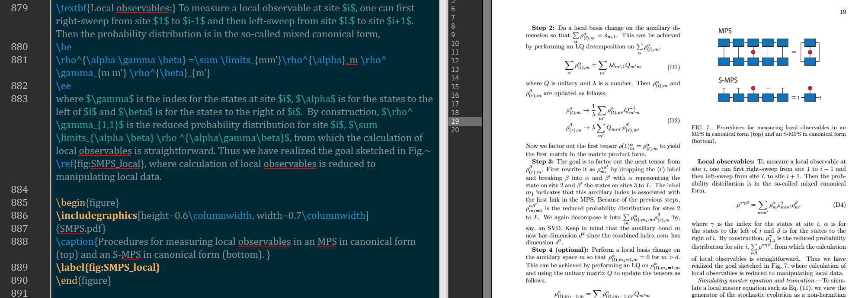
An example of LaTeX

Slide 33
What are the advantages of using Programming in Physics?
Robustness
Minimizing “human error”
Portability
Sharing and Collaborating with your friends
Reusability
Building upon from previous work

